Slide 1

BUSINESS COMMUNICATIONS 500
TOPIC: FOUR
Reports, Proposals, and Presentations
Welcome TO Richfield
HYBRID learning

Slide 2
Learning Objectives
In this chapter, you will learn about:
Locate and evaluate secondary sources such as databases and Internet resources,and understand how to conduct credible primary research.
Analyse, sort, and interpret statistical data and other information using tables, measures of central tendency (mean, median, and mode), and decision matrices.
Discuss the components of formal and grant proposals.
Identify the components of typical business plans.
Recognize various types of business presentations,and discuss two important first steps in preparing for any of these presentations.

Slide 3
Introduction
Digital age organizations compete in a world of constant change facilitated by innovative
technology and the ability to generate and share vast amounts of data.
Efficient reporting plays a critical role in helping organizations sift through data and make major decisions. Whether a company decides to launch a new product, expand into new markets, reduce expenses, improve customer service, or increase its social media presence, the decisions are usually based on information submitted in reports.
Routine reports keep managers informed about work in progress. Focused, in-depth reports help managers analyse the challenges they face before recommending solutions.

Slide 4
Identifying secondary sources and conducting primary research
Research, or the gathering of information, is one of the most important steps in writing a report.
As you analyse a report’s purpose and audience and prepare your research strategy, you will identify and assess the data you need to support your argument or explain your topic. As you do, you will answer questions about your objectives and audience: Will the audience need a lot of background or contextual information? Will your readers value or trust statistics, case studies, or expert opinions? Will they want to see data from interviews or surveys? Will summaries of focus groups be useful? Should you rely on organizational data?

Slide 5
Organizing data
Collect data
Interpret
Draw up a conclusion.

Slide 6
Writing short informational reports & Preparing short analytical reports
Assume your readers are not as knowledgeable on the topic as you are. ...
Use the correct scientific and technical terms in your report.
Find or create some labelled diagrams if possible.
Use paragraphs effectively
This section describes three common types of analytical business reports:
(a) justification/recommendation reports,
(b) feasibility reports, and
(c) yardstick reports.

Slide 7
Preparing formal proposals
Formal proposals differ from informal proposals not in style but in size and format. Formal proposals respond to big projects and may range from 5 to 200 or more pages.
Because proposals are vital to the success of many organizations, larger businesses may maintain specialists who do nothing but write proposals. Smaller firms rely on in-house staff to write proposals.

Slide 8
Creating effective business plans
What is a business plan?
A written document describing the nature of the business, the sales and marketing strategy, and the financial background, and containing a projected profit and loss statement.
A business plan is critical for securing financial support of any kind. Such a plan also ensures that you have done your homework and know what you are doing in launching your business.
It provides you with a detailed road map to chart a course to success.

Slide 9
Creating effective business presentations
A common part of a business professional’s life is making presentations. Some presentations are informative, whereas others are persuasive. Some are face-to-face; others, virtual.
Some are performed before big audiences, whereas others are given to smaller groups. Some presentations are elaborate; others are simple.
Types of business presentations
Brief
Report
Podcast
Virtual presentation
Webinar

Slide 10
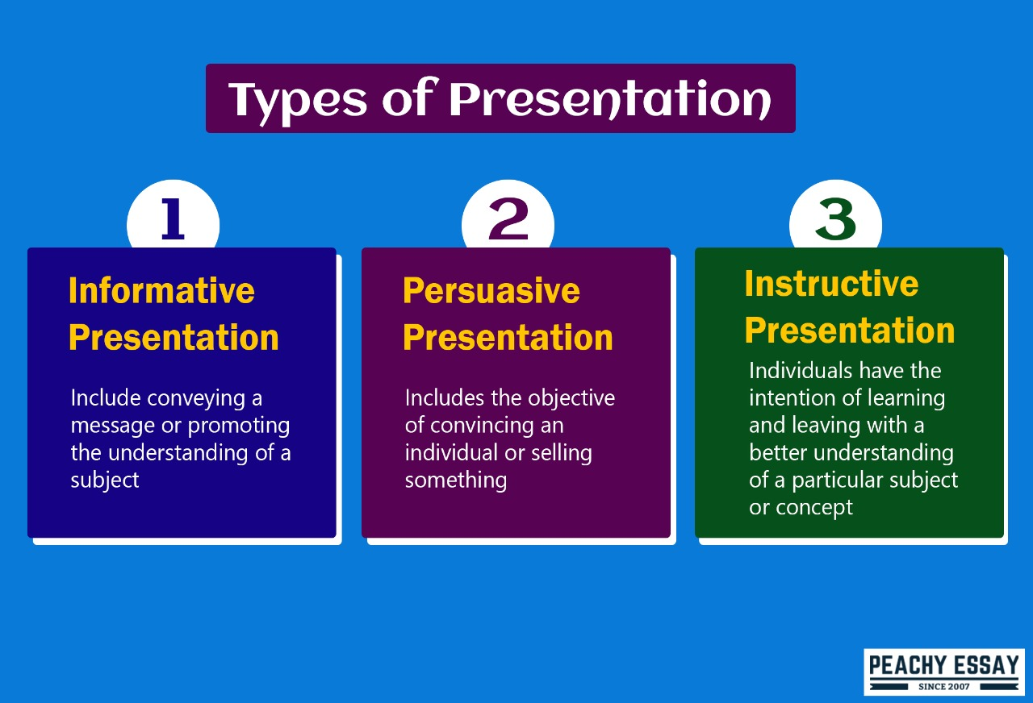
Types of presentations

Slide 11
Preparing engaging multimedia presentations
When operated by proficient designers and skillful presenters, PowerPoint, Keynote, or Prezi can add visual impact to any presentation. With any software program, of course, gaining expertise requires an investment of time and effort.
The Meaning of Color. Adapt the slide colors based on where you will give the presentation. Use light text on a dark background for presentations in darkened rooms. Use dark text on a light background for presentations in lighted rooms.
Avoid using a dark font on a dark background, such as red text on a dark blue background. In the same way, avoid using a light font on a light background, such as white text on a pale blue background.

Slide 12
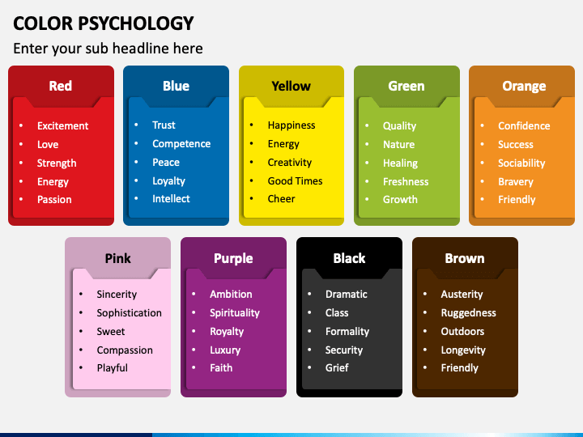
ENGAGING MULTIMEDIA PRESETNATIONS

Slide 13
Tabulating and analyzing data:
Tabulation or a table chart is an easy way of organizing complex or large volumes of data across multiple categories or types and representing them together to draw valuable conclusions from them.
A table represents even a large amount of data in an engaging, easy to read, and coordinated manner. A table chart uses a set of data arranged in rows and columns.

Slide 14
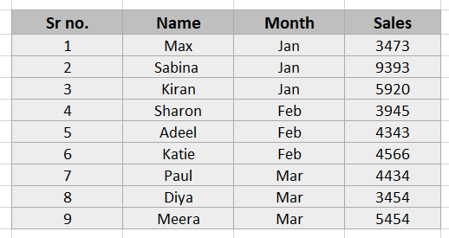
Tabulating and analyzing data

Slide 15
Tabulating and analyzing data
To display large amounts of data, the use of graphs and charts can make the information easier to view and interpret.
To display data, there are many graphs and charts available.
Select the most appropriate graph or chart to convey the information effectively.
For data that is organized into different groups or categories, bar graphs or bar charts are most often used to display the information.

Slide 16
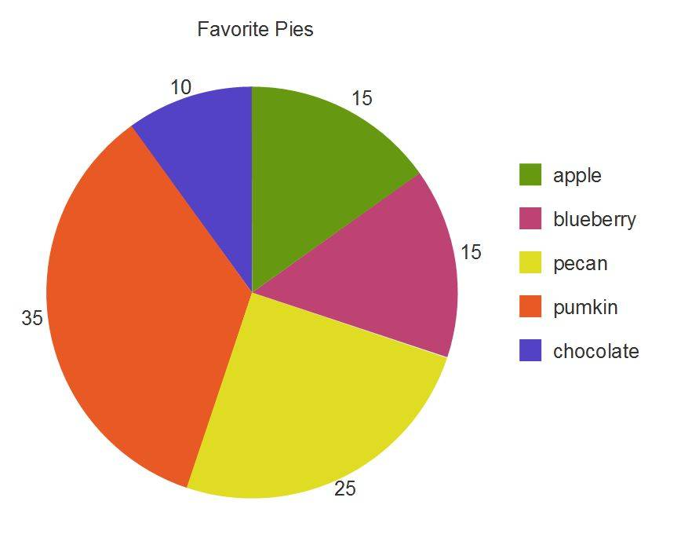
Tabulating and analyzing data

Slide 17
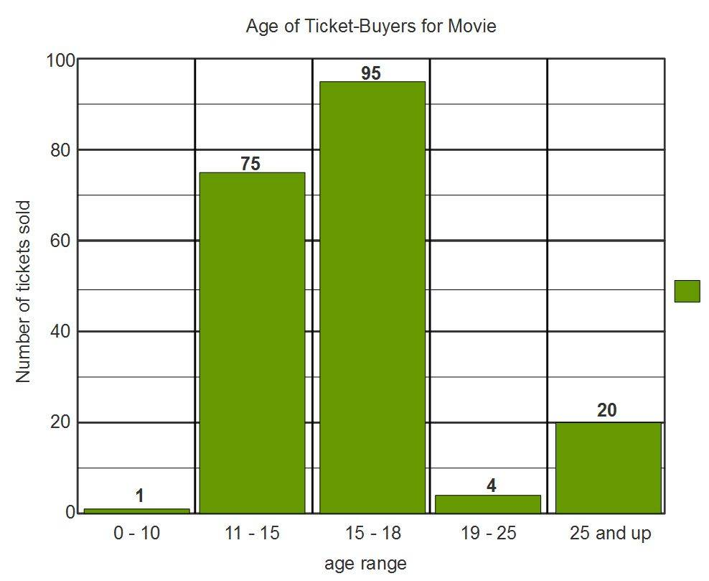
Tabulating and analyzing data

Slide 18
Mean ,median ,mode
Mean: The value obtained by dividing the sum of the observations by the number of observations. It is often called average.
Median: The middlemost value in the ordered list of observations.
Mode: The most frequently occurring value.

Slide 19
Calculate:
Dormmate | Number of minutes on social media
Vera | 13
Timothy | 0
Manueala | 14
Khaled | 36
Yash | 18
Fernanda | 12

Slide 20
COMPUTE THE FOLLOWING.
Nine homes recently sold in your community in the following order and for these amounts: $360,000; $460,000; $360,000; $380,000; $360,000; $420,000; $380,000; $520,000; and $360,000.
Your boss, Andrew Santoso, a realtor with Hagen & Associates, wants you to compute the mean, median, and mode for this real estate market.
Compute the mean, median, and mode for the recently sold homes.

Slide 21
Developing intercultural and team presentations
Most of the information presented thus far assumes you are a single presenter before a traditional audience. However, in this digital global world of work, presentations take on myriad forms and purposes. Now we’ll explore effective techniques for adapting presentations to inter- cultural audiences and participating in team presentations.
Adapting Presentations to Intercultural Audiences.
Understanding Different Values and Nonverbal Behaviors.
Adjusting Visual Aids to Intercultural Audiences.

Slide 22
THANK YOU
PG 106

